Slide 1
How do individuals protect them self from interviews based on social medias
Ashfaaq Ahamed - 2019394

Slide 2
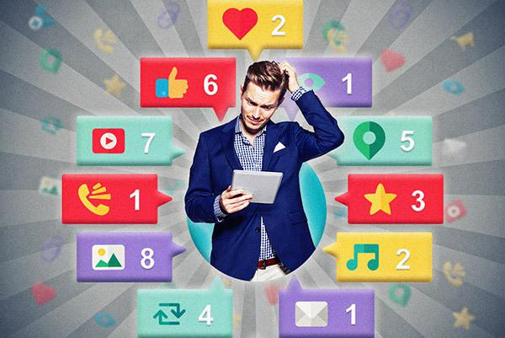
Issues which are created
Posting on public.
Activity status
Checking their background in normal life
Their capabilities can be monitored

Slide 3
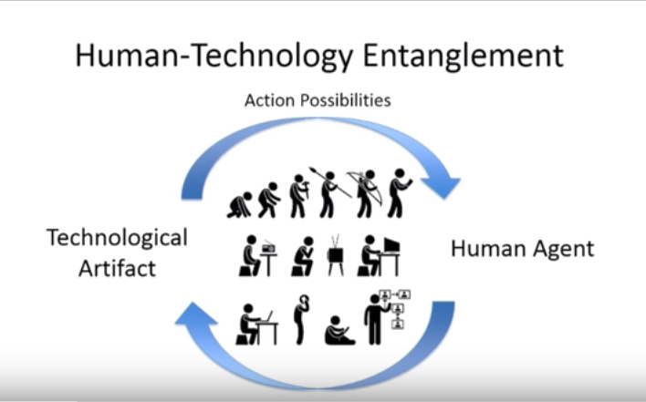
Major problems that are faced by individuals
Lack of job opportunities.
Skilled personals get rejected.
Creates a barrier in social life
Lack of self-control

Slide 4
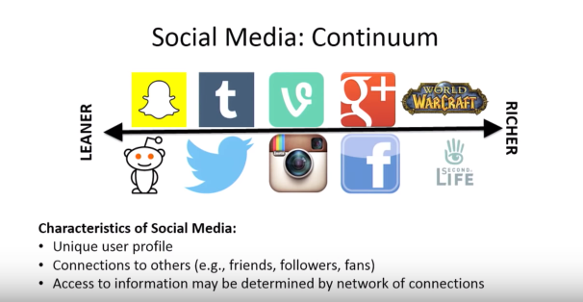
Solutions
Collect information about the interviewer if you get information early handed
Monitor your accounts regularly
Awareness of what you share

Slide 5
Reference links
https://www.researchgate.net/publication/323014365_The_impact_of_social_media_on_social_lifestyle_A_case_study_of_university_female_students
https://www.researchgate.net/publication/261551701_Research_using_Social_Media_Users'_Views

Slide 6
Images links
https://www.youtube.com/watch?v=CSpyZor-Byk (Screen-shots)

